Slide 1
User Experience Made Easy for Color Blind
Presented by
Akhila kotapati
Sirisha patibandla
Thrinath reddy shaga

Slide 2
review
Color blindness is an abnormal condition characterized by the inability to clearly distinguish different colors of the spectrum.
There are several types of color blindness which are characterized by the colors one cannot view.

Slide 3
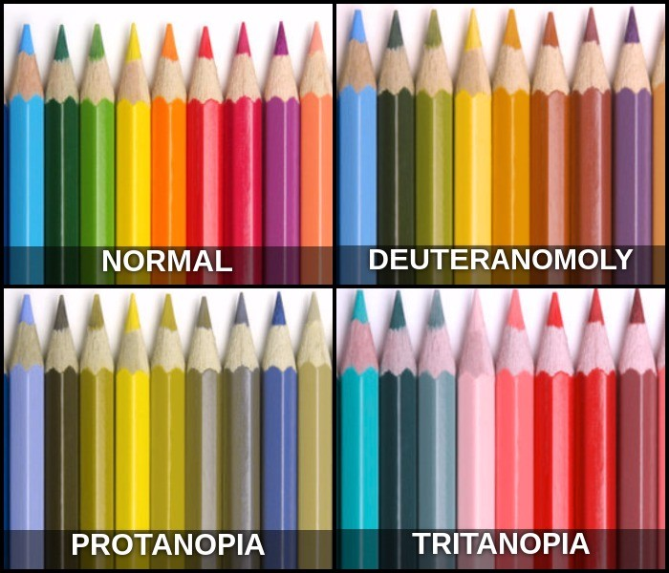
review
1.Protanopia
2.Deuteranopia
3.Tritanopia

Slide 4
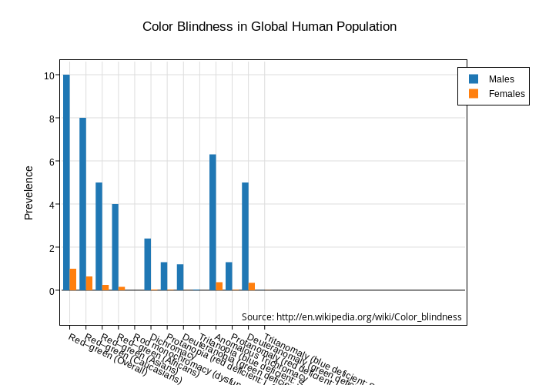
review
There are approximately 5 to 8 percent of male population and less than 1 percent of female population effected by color blindness.
In this, about 110 million web users who are color blind.

Slide 5
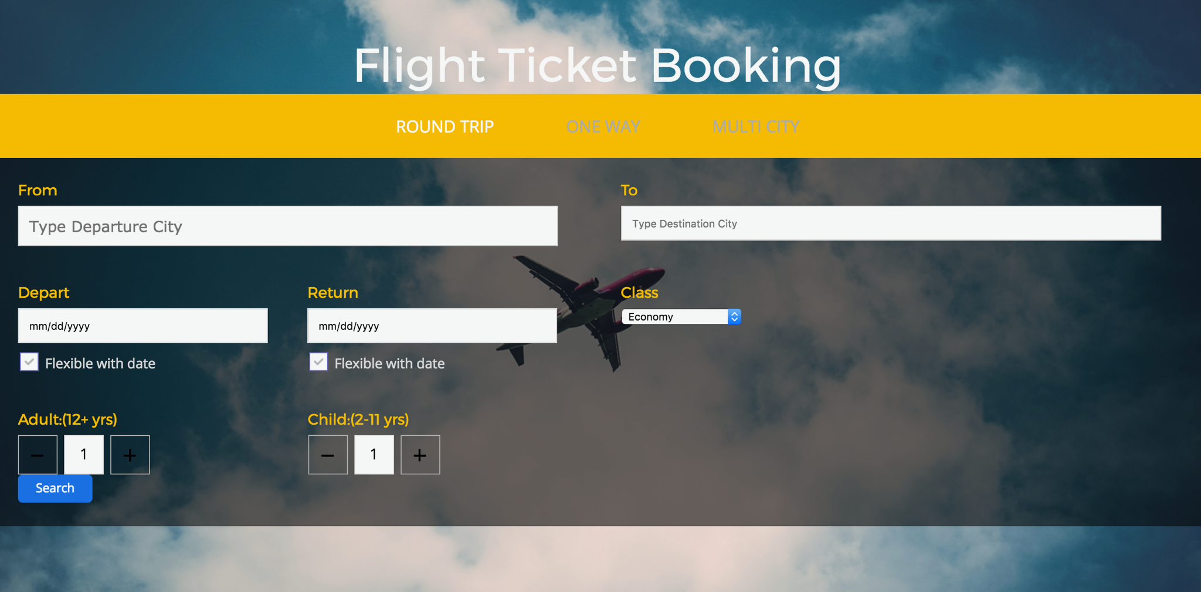
Use case: Airplane seat booking
Homepage img

Slide 6
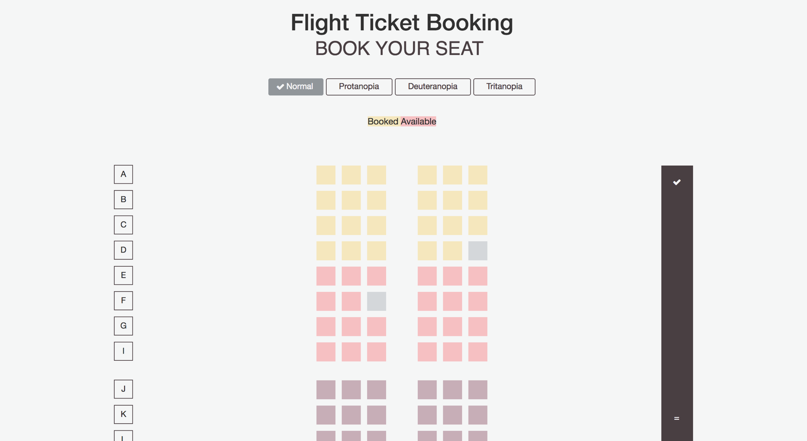
Use case: Airplane seat booking
Seat booking

Slide 7


protanopia
a defect of vision in which the retina fails to respond to red or green.

Slide 8
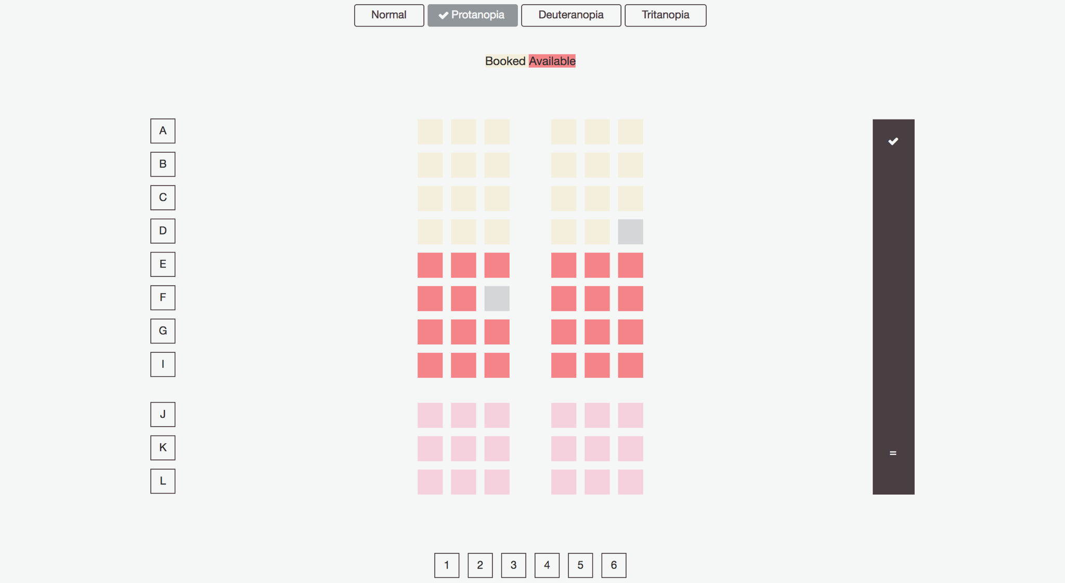
Use case: Airplane seat booking
Seat booking for protonopia

Slide 9
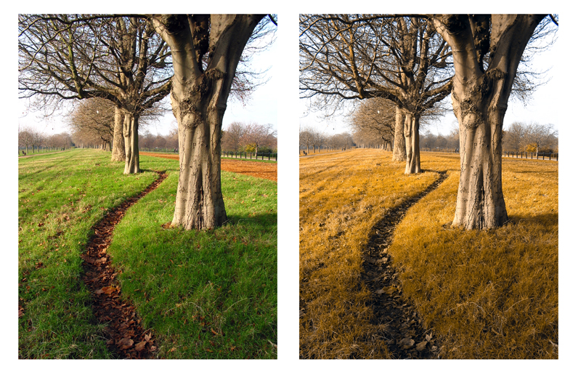
deuteranopia
a defect of vision in which the retina fails to respond to the color green.

Slide 10
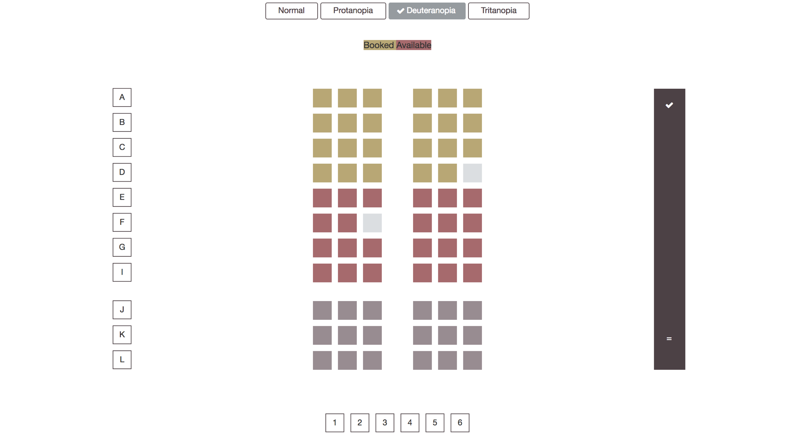
Use case: Airplane seat booking
Seat booking for deuteranopia

Slide 11
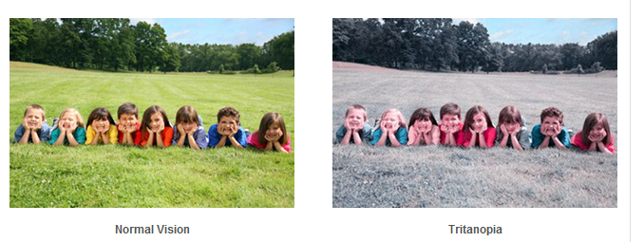
tritanopia
a defect of vision in which the retina fails to respond to blue and yellow.

Slide 12
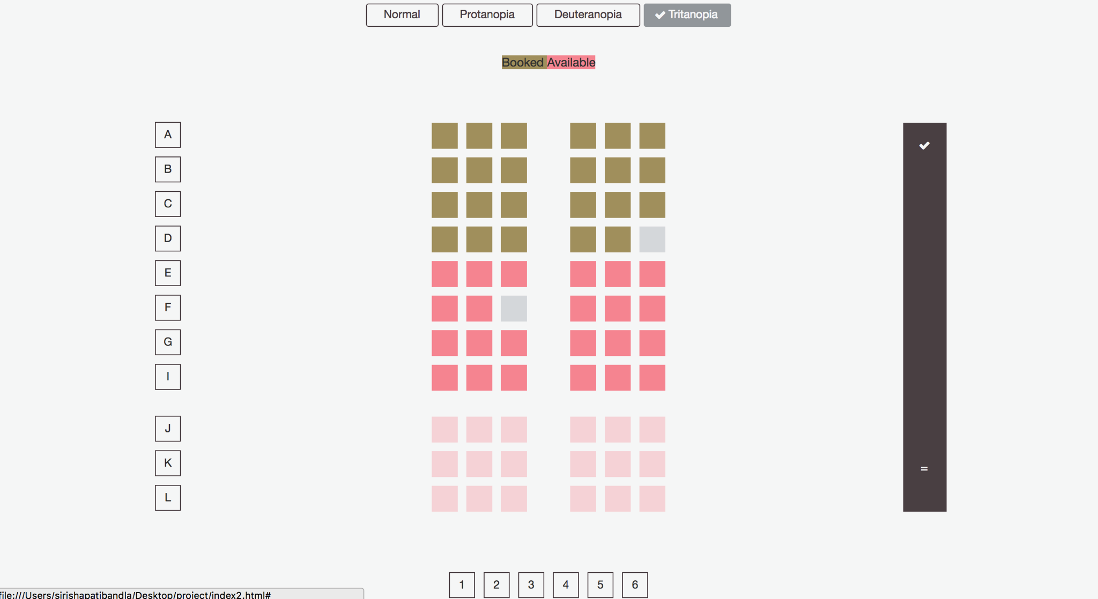
Use case: Airplane seat booking
Seat booking for tritanopia

Slide 13
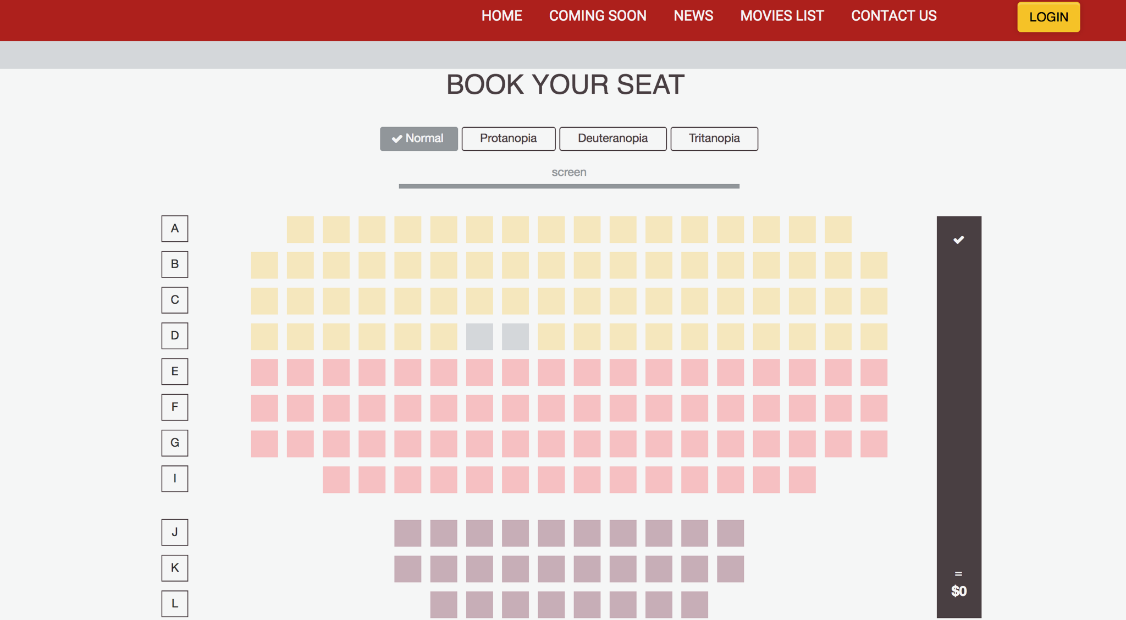
Use case: movie theater seat booking

Slide 14
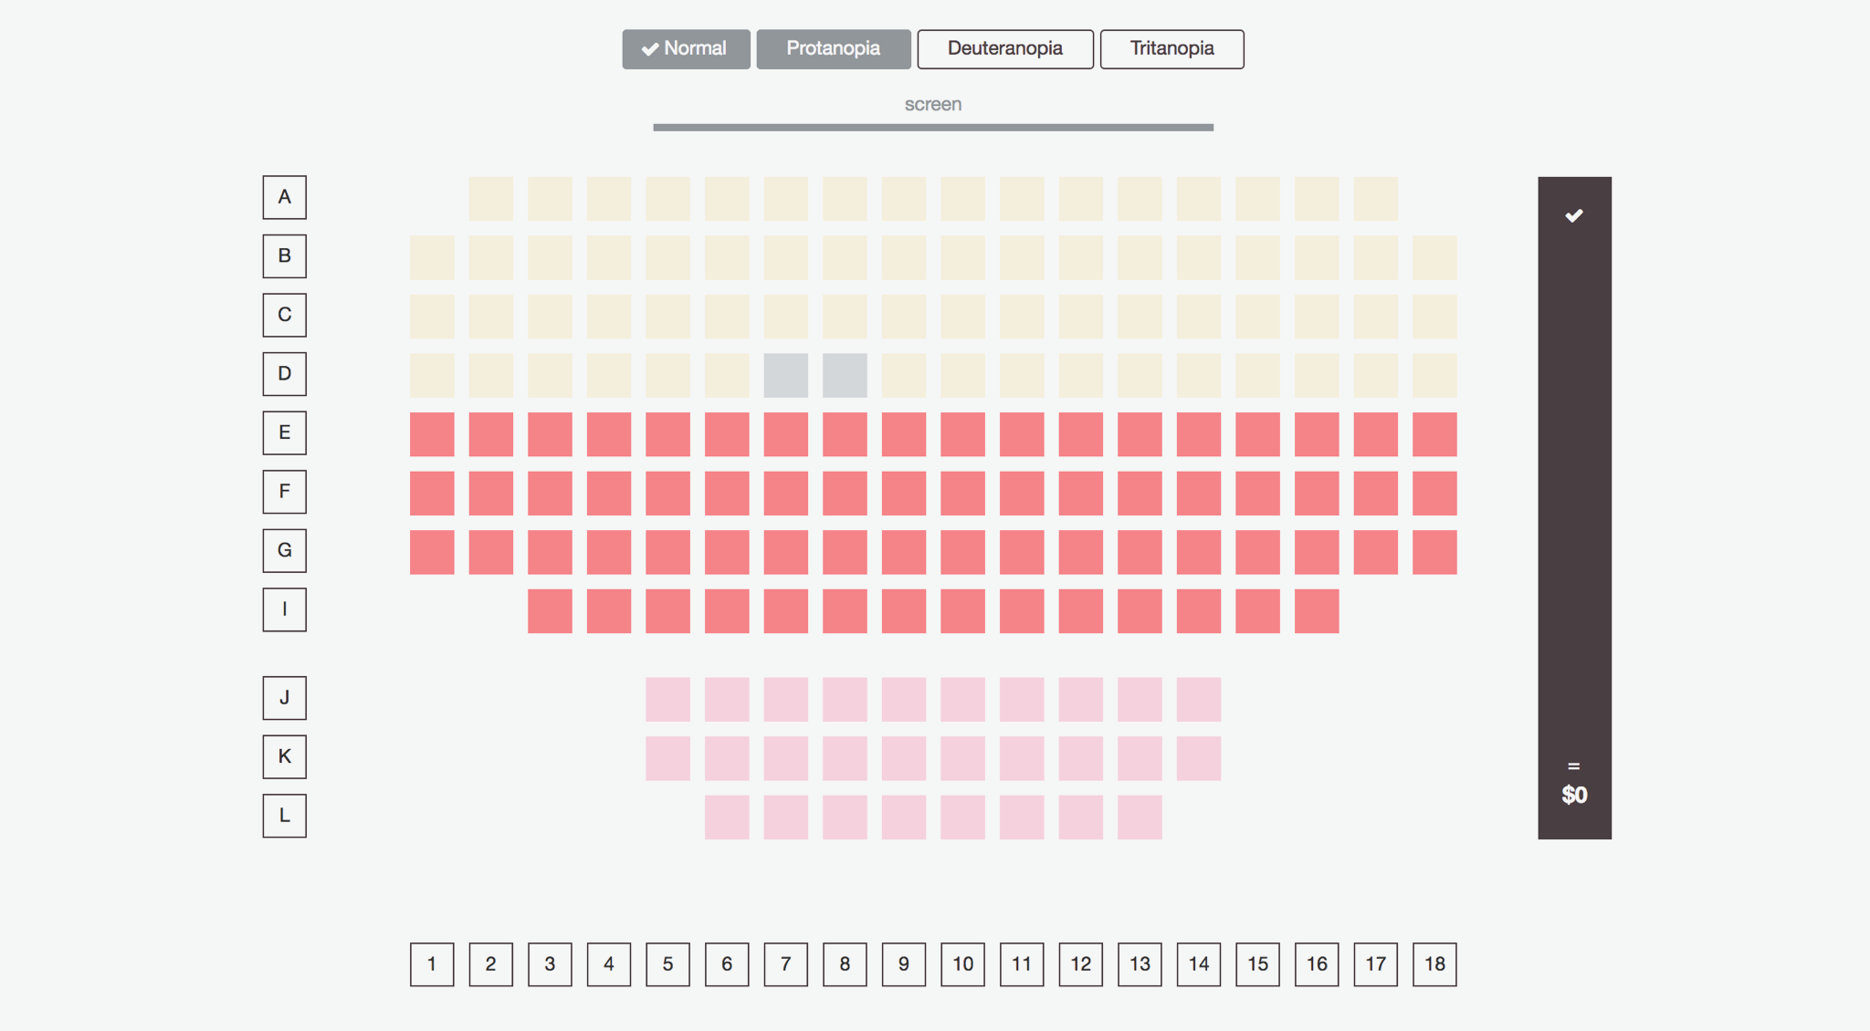
Use case: movie theater seat booking

Slide 15
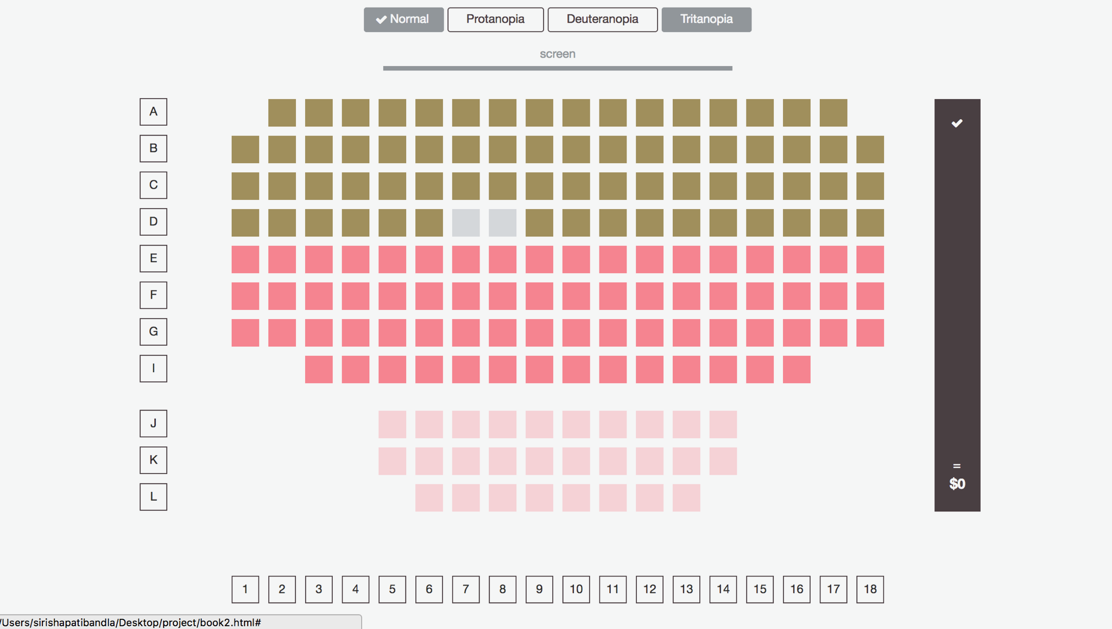
Use case: movie theater seat booking

Slide 16
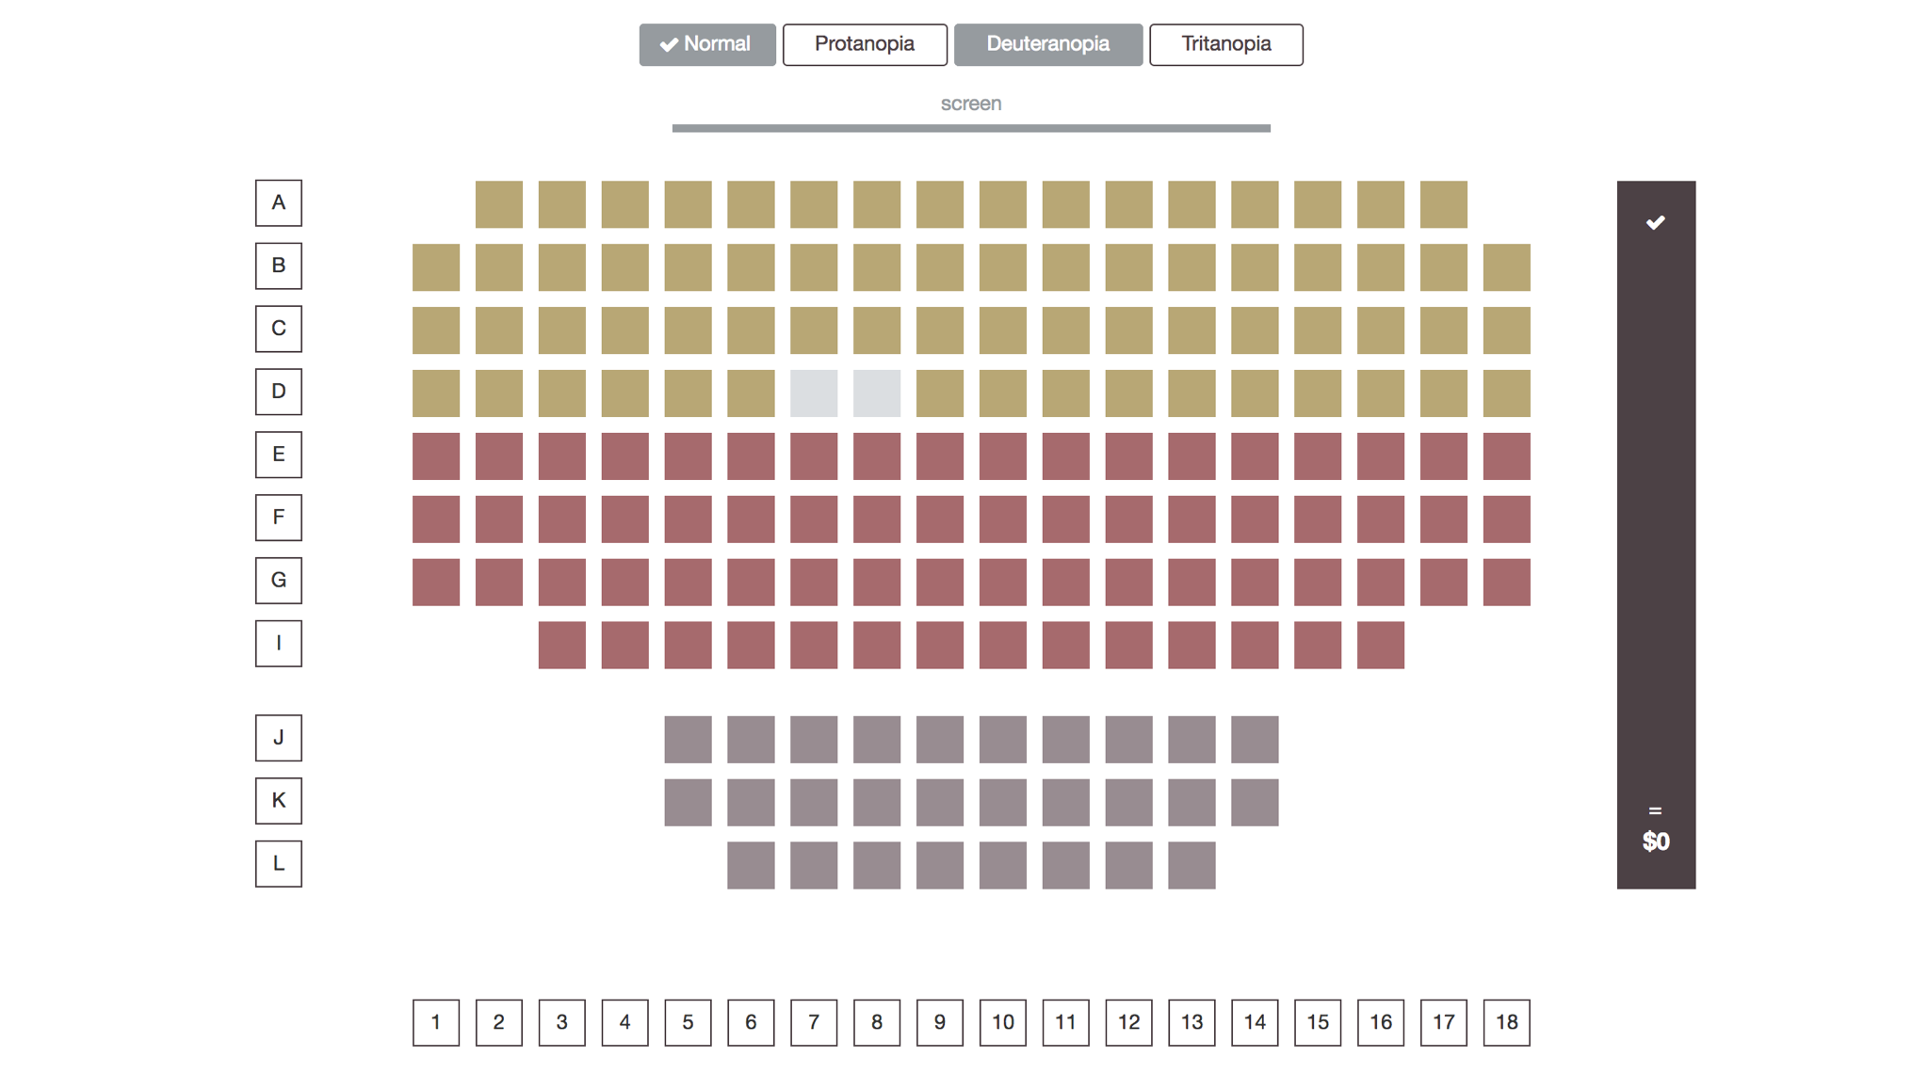
Use case: movie theater seat booking

Slide 17
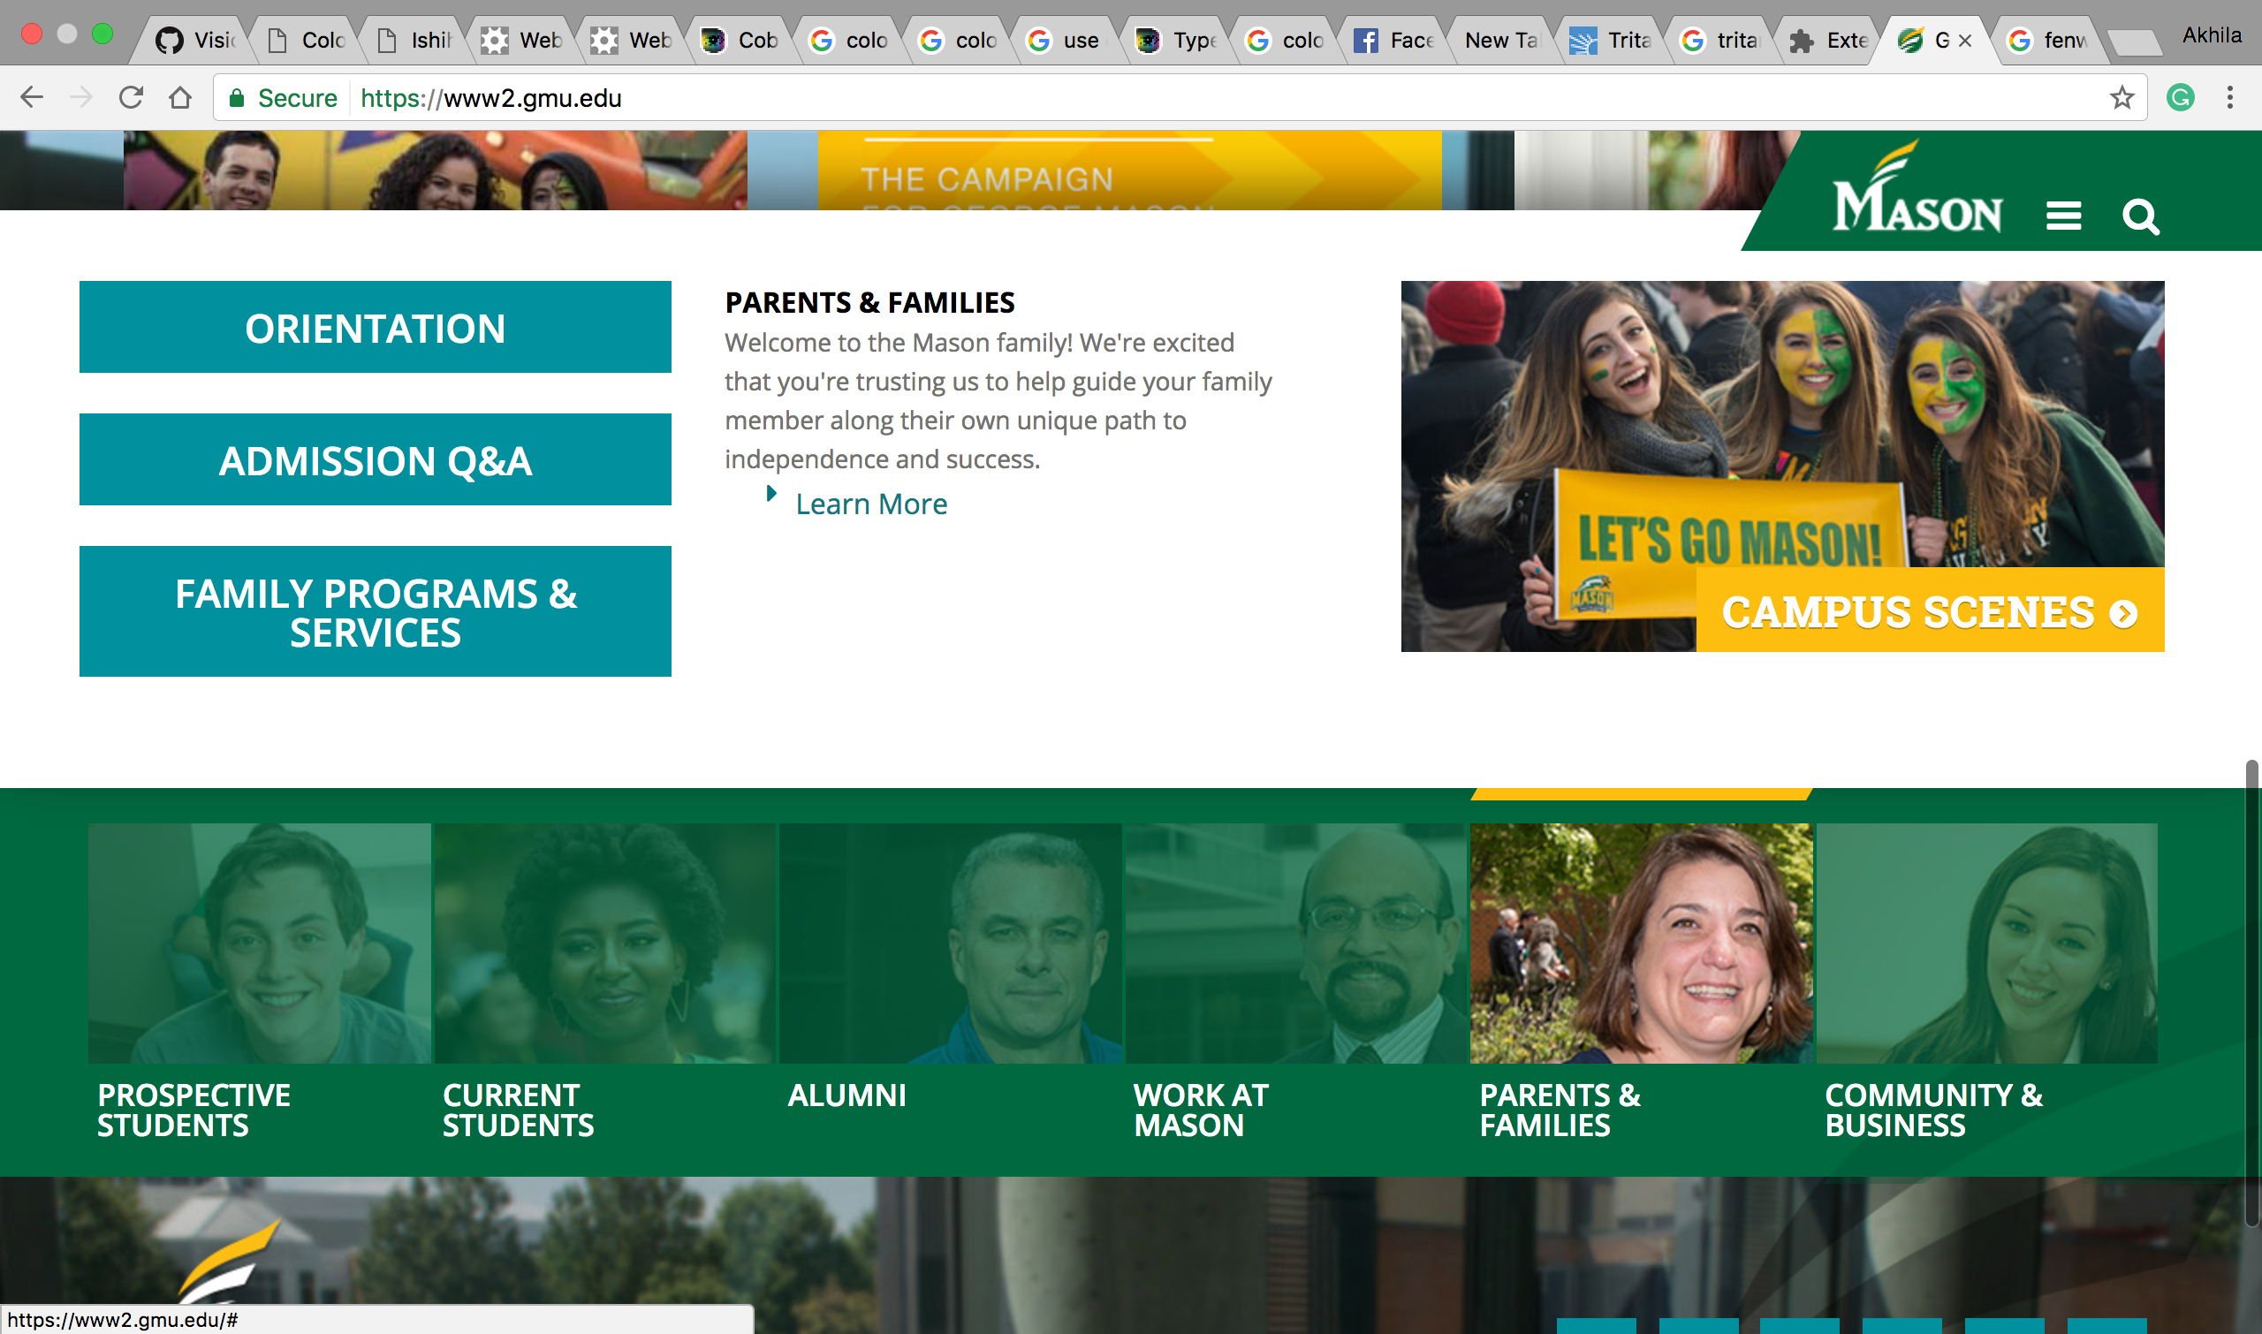
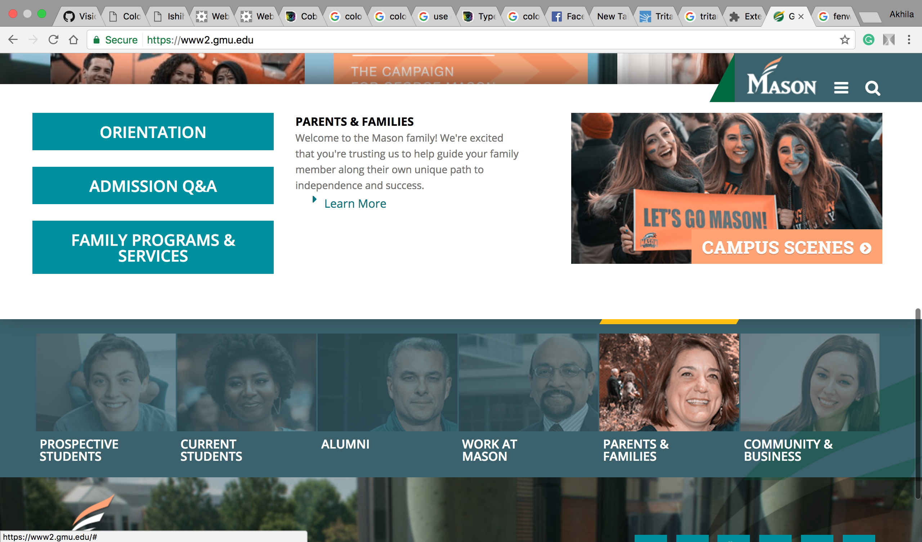
Implementing plugin

Slide 18
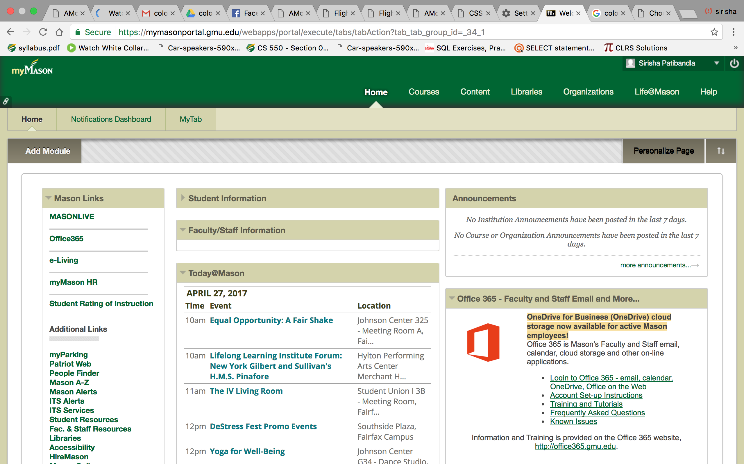
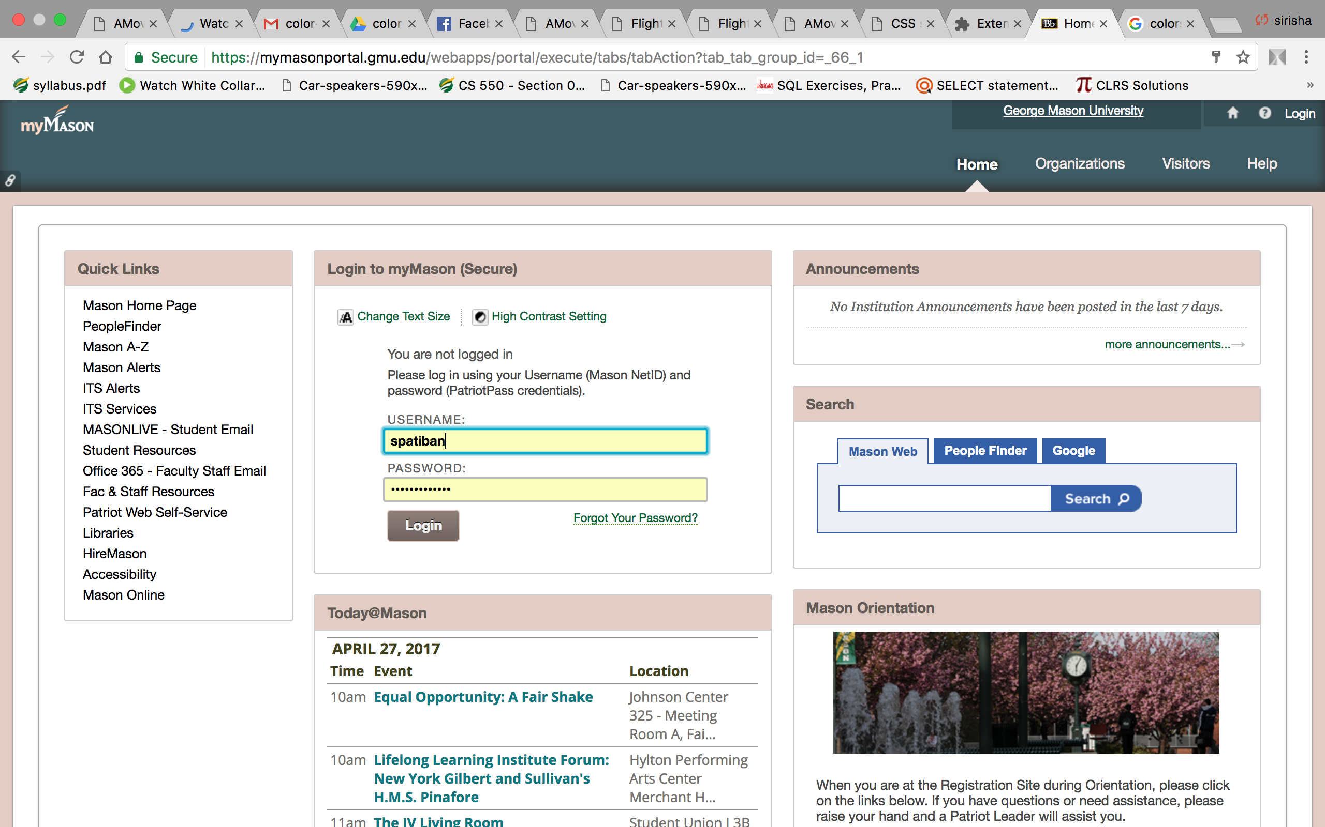
Implementing plugin

Slide 19
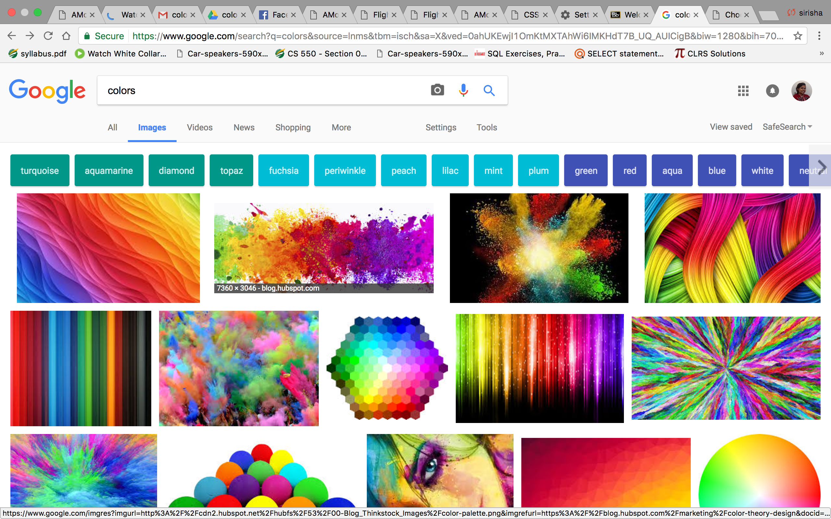
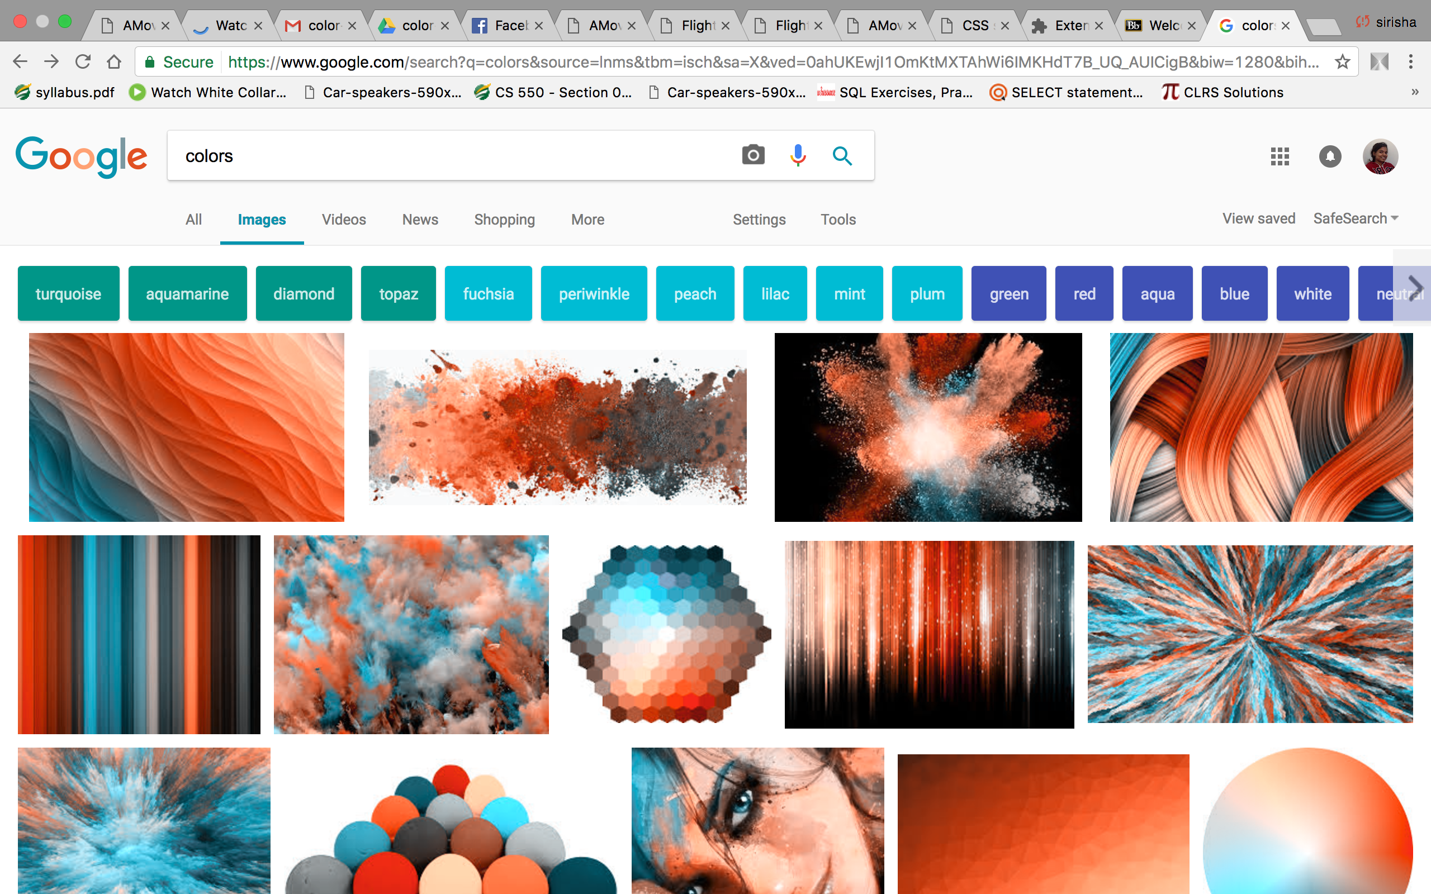
Implementing plugin

Slide 20
THANKYOU

